Slide 1

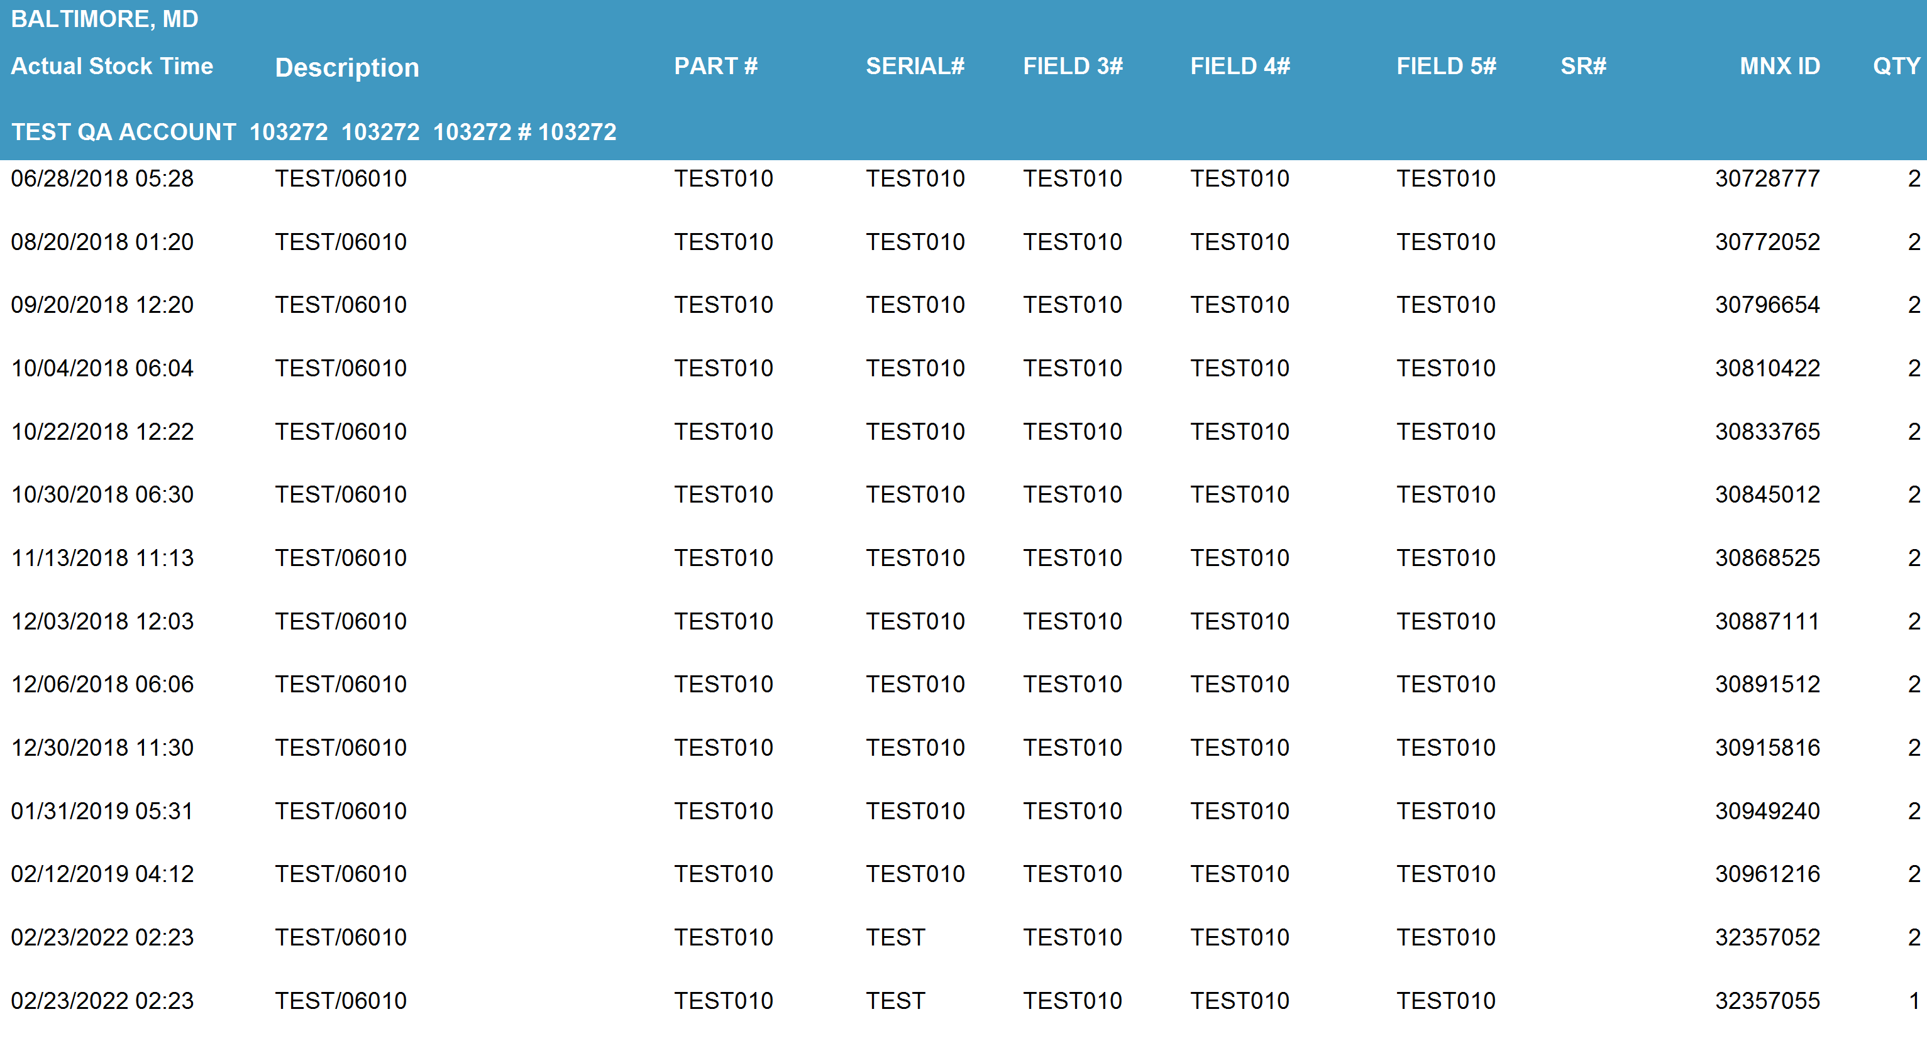
Inventory Receipt Report
*Data provided should be considered CONFIDENTIAL and PROPRIETARY*
©2011-2023 MNX Global Logistics. All rights reserved.
6/23/2023 4:22 AM
Print User : mobile

Slide 2
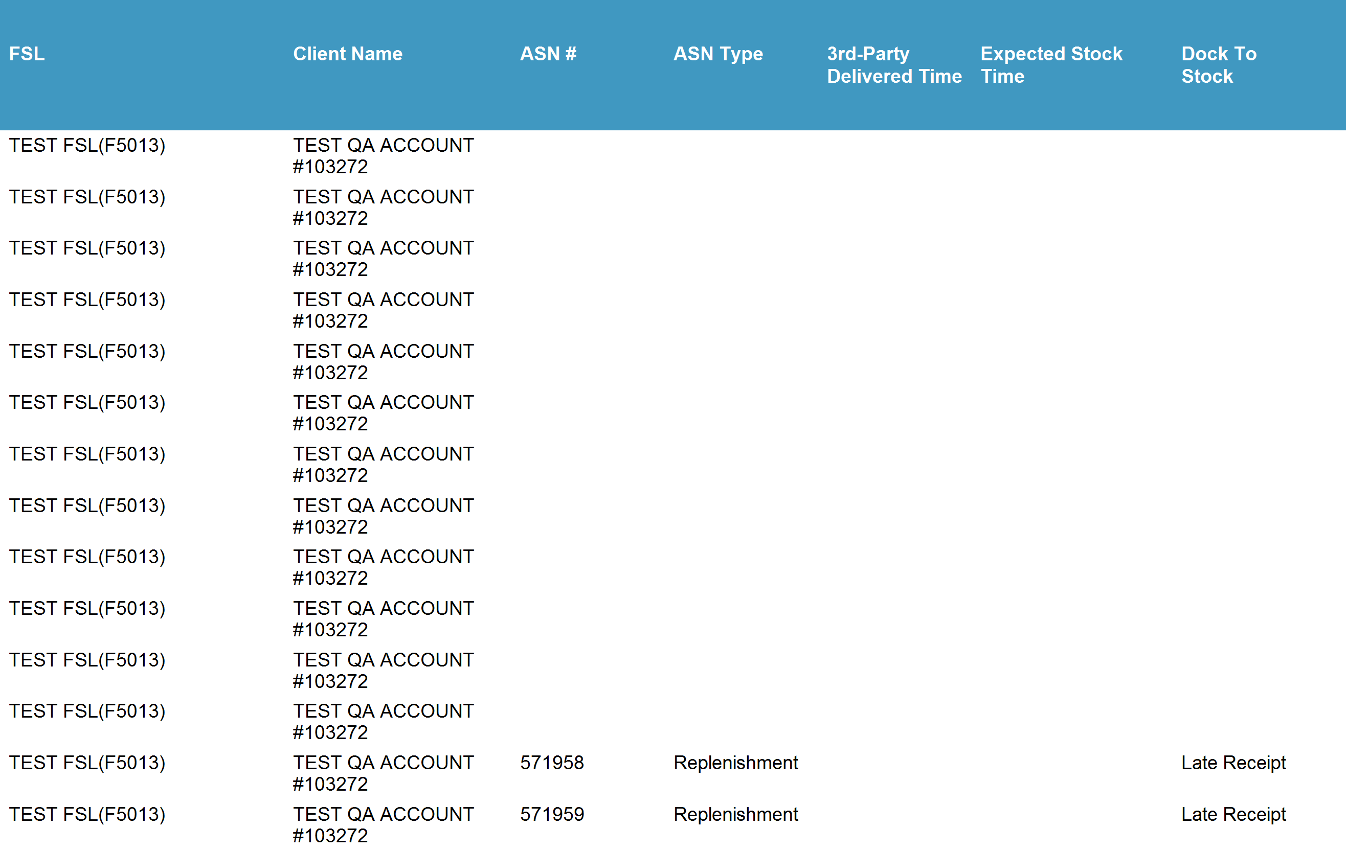
Inventory Receipt Report
*Data provided should be considered CONFIDENTIAL and PROPRIETARY*
©2011-2023 MNX Global Logistics. All rights reserved.
6/23/2023 4:22 AM
Print User : mobile

Slide 3
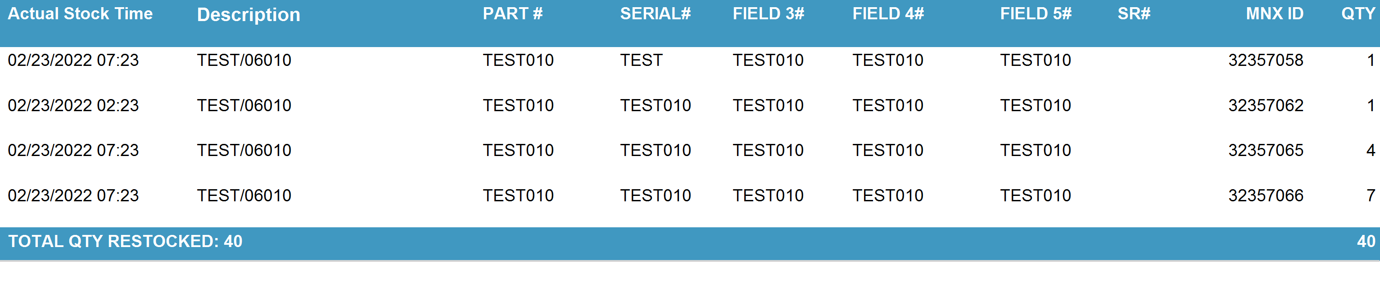
Inventory Receipt Report
*Data provided should be considered CONFIDENTIAL and PROPRIETARY*
©2011-2023 MNX Global Logistics. All rights reserved.
6/23/2023 4:22 AM
Print User : mobile

Slide 4
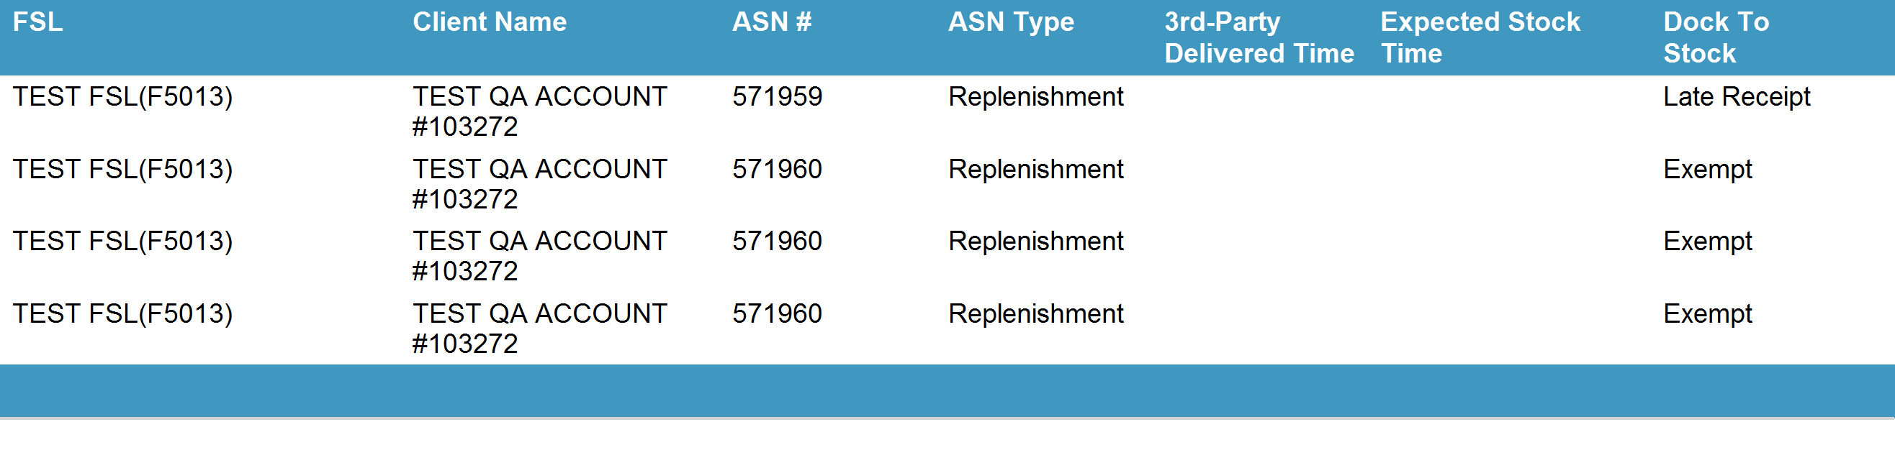
Inventory Receipt Report
*Data provided should be considered CONFIDENTIAL and PROPRIETARY*
©2011-2023 MNX Global Logistics. All rights reserved.
6/23/2023 4:22 AM
Print User : mobile

